Slide 1
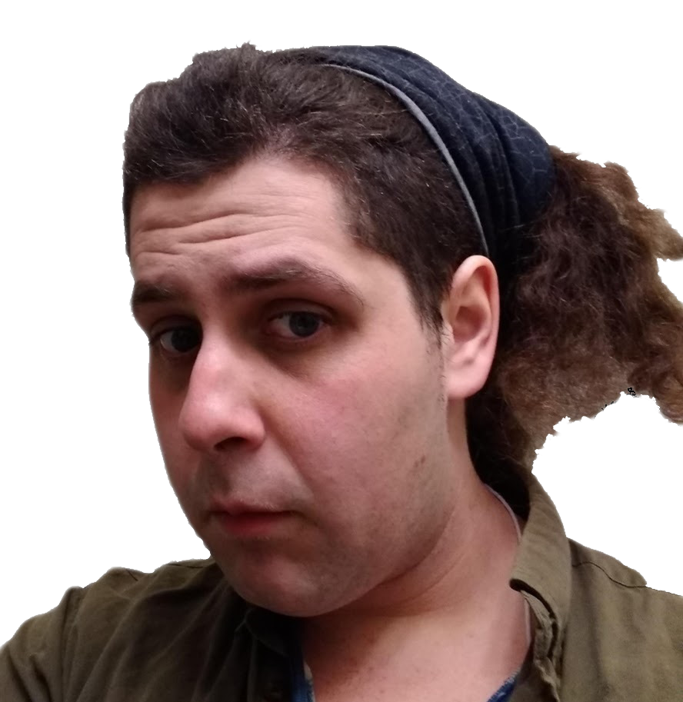


April Cyr
Allow me to introduce myself..

Slide 2

Story of Self
After getting my Bachelors Degree in Behavioral Psychology in 2014, I experienced nomadic homelessness. I walked across states, couchsurfed, rode greyhound buses, and slept outdoors many nights. When I came to Asheville in January 2017, I lived out of a vehicle and went to free meal programs every day. I’d volunteer busing, washing dishes, and cleaning. Got to break bread with many different types of people. There were many barriers getting back into housing and employment. After I filed for my legal name and sex designation change things slowly started getting better. I have had stable housing the past four years, am in school, and work part-time for Student IT. I still participate and volunteer with free food programs. Our current systems consistently fail to support and protect adults with disabilities, the homeless, LGBT, refugees, and other displaced people. I am in school learning digital technologies in hope to make the world safer and more accessible for displaced persons through the modern computer and internet.

Slide 3
Projects on Display
April’s Apple Chips
Iron Fence Society / Peace Volcano
Adult Competencies Assessment
Secret Sauce to being a digital writing ninja

Slide 4

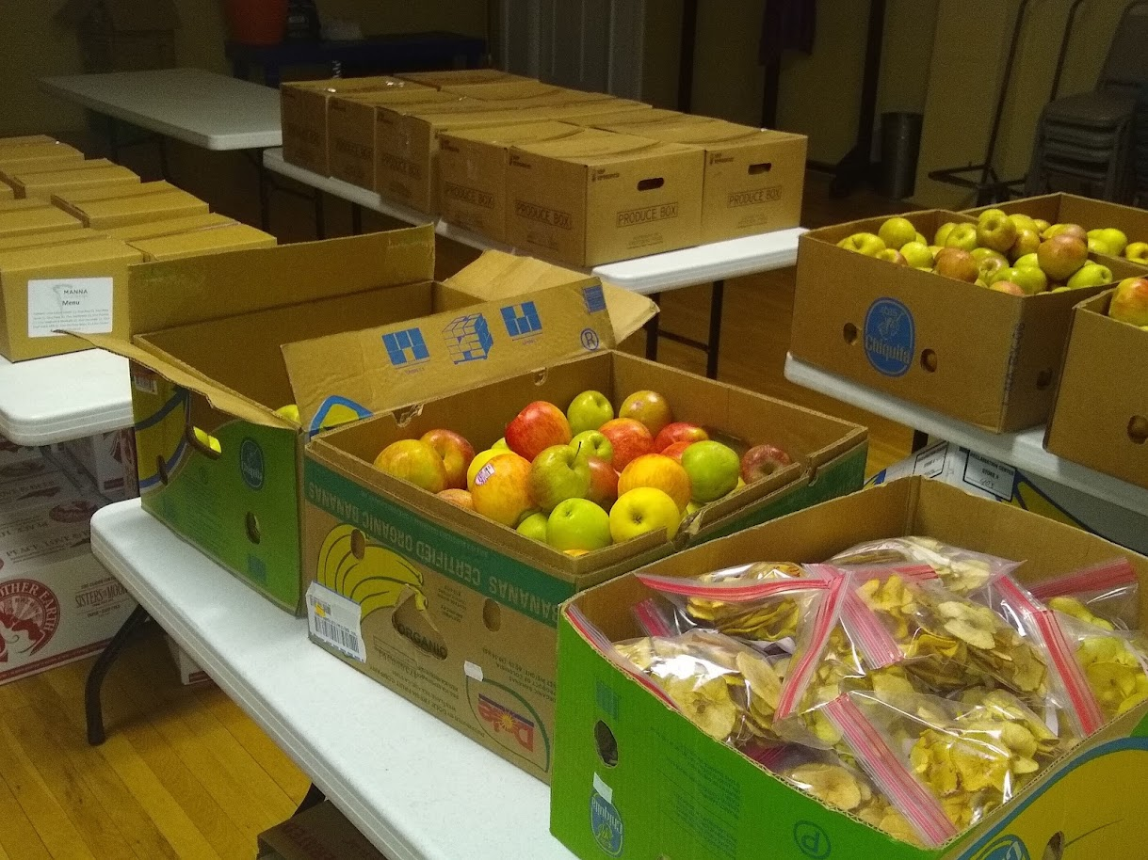
April’s Apple Chips was my cooking LLC for three years.
Cooked in-home with clients, did custom menu event parties, & kitchen logistics
Manufactured dried snacks from thousands of pounds of free apples seasonally
See link for mini-gallery and slideshow on food preservation.

Slide 5
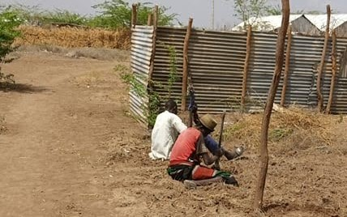
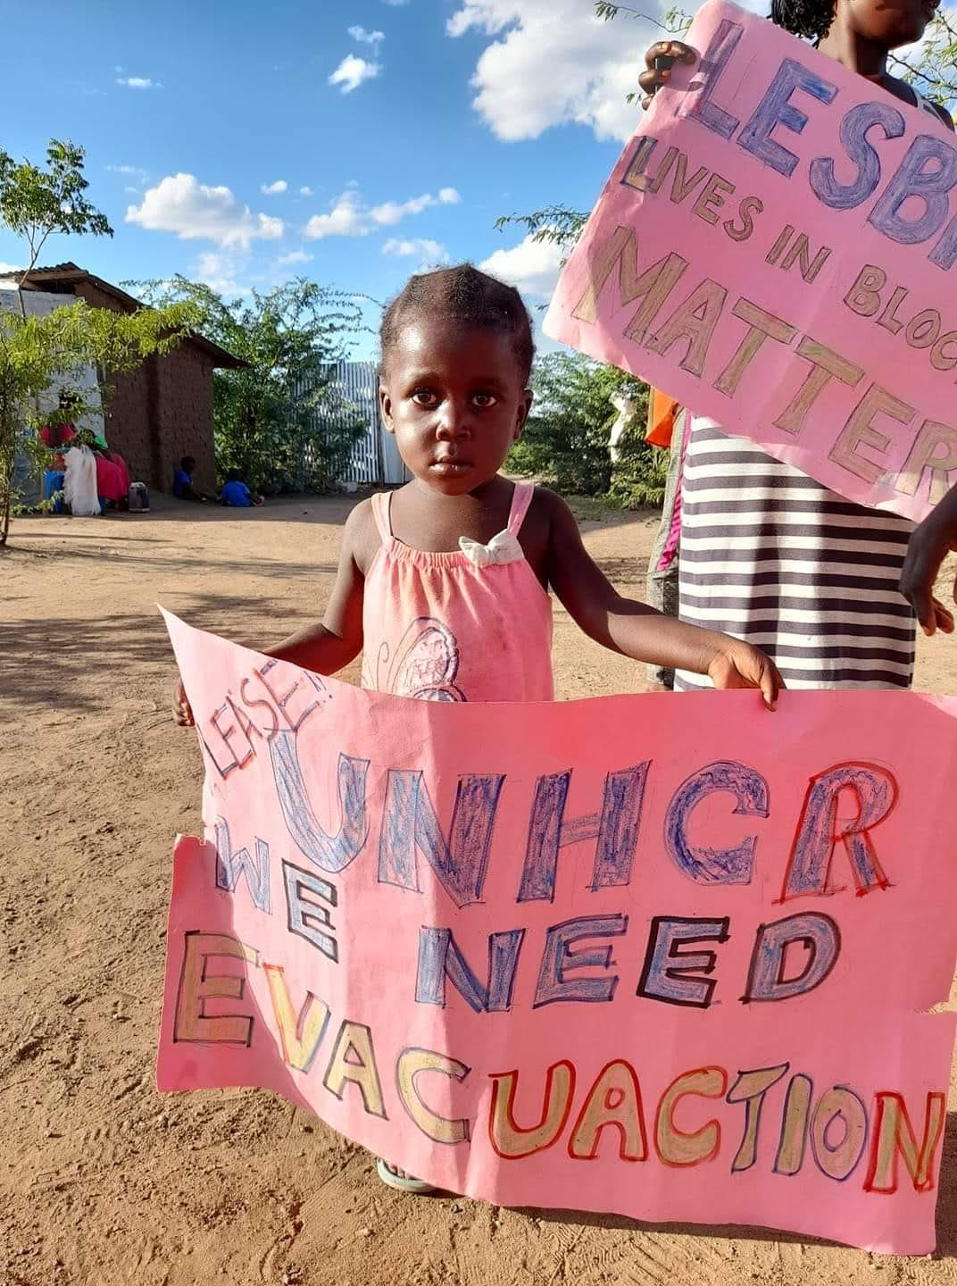

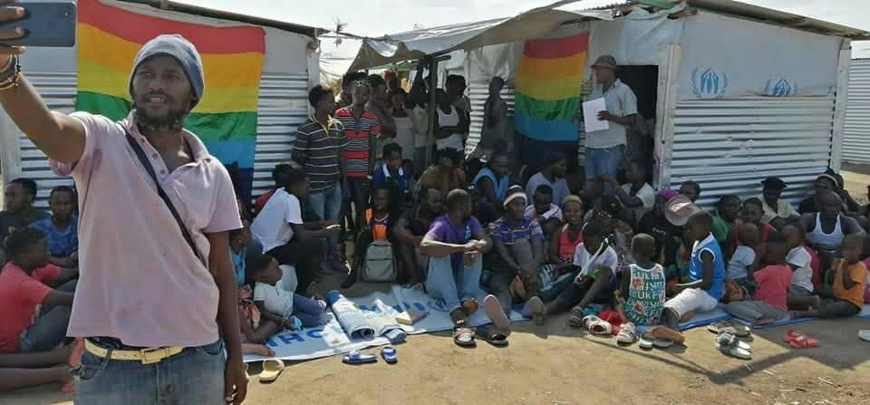
Iron Fence Society
Connected with LGBT Refugees in the Kakuma Refugee Camp over social media
Refugees living in violence, rock throwing, shelter arson, medical discrimination, police brutality
Partner had gotten high paying job and more money than could do with, sent 10k in direct donations to over 18 individuals, funding bulk supply purchase, and construction of three protective fencing projects.
Wrote a 40 page report about conditions and how to donate safely to refugees. Addressed to United Nations with plea that people targeted by hate crime violence have right to protective fencing and privacy in their domicile.
See mini-gallery for pictures, link to PDF Download of report in Chat.

Slide 6

Adult Competencies Assessment
My Capstone Project is a questionnaire tool that helps people with disabilities identify core strengths and weaknesses in everyday life skills among 188 questions over six sections:
1) Independent Living
2) Body & Me
3) Interact!
4) Relationships
5) Executive Functioning
6) Orientation, Expression, & Play
Link to Overview Brief & Assessment Webpage in Chat

Slide 7
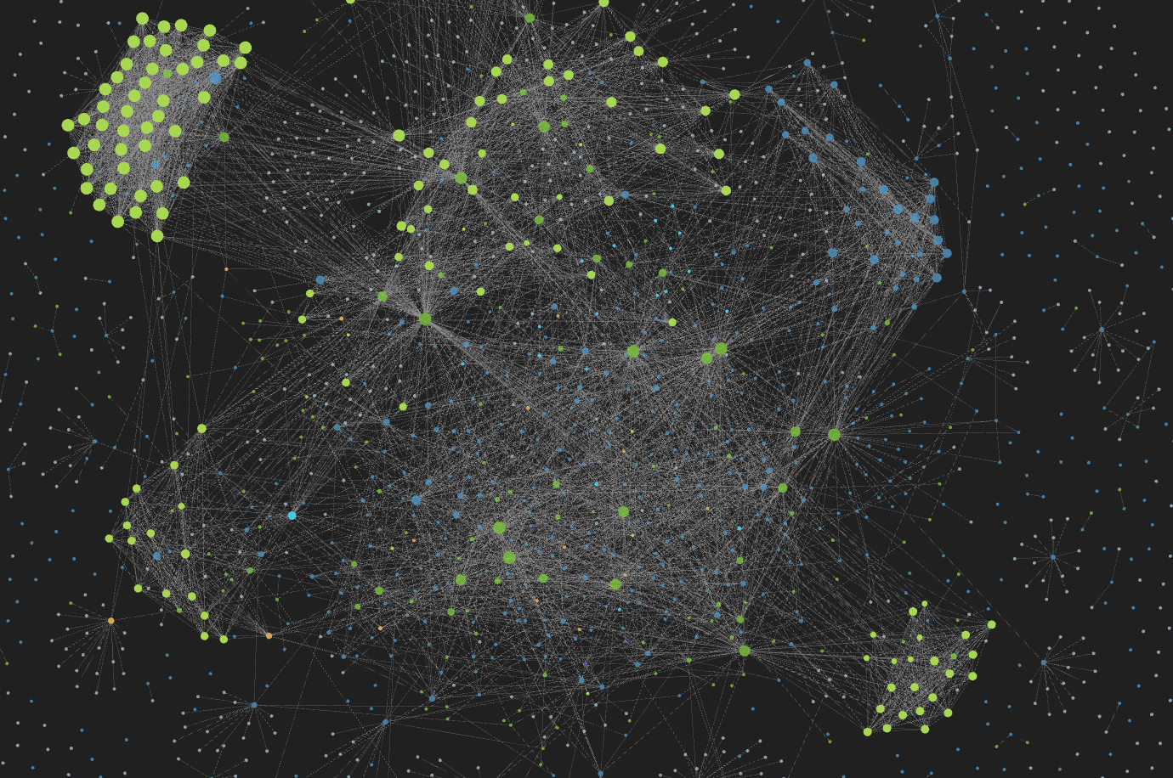
Website & Second Brain
I use a Note Manager called Obsidian. It is free. If you write a lot, or take a lot of notes digitally, please consider a good Note Manager and learning some basic Markdown. It’s super easy & will make your work easier and much more effective.
My website under construction is www.aachips.co. It will be a hub and library of helpful resources & I will be taking more Web Development courses this Fall.

Slide 8
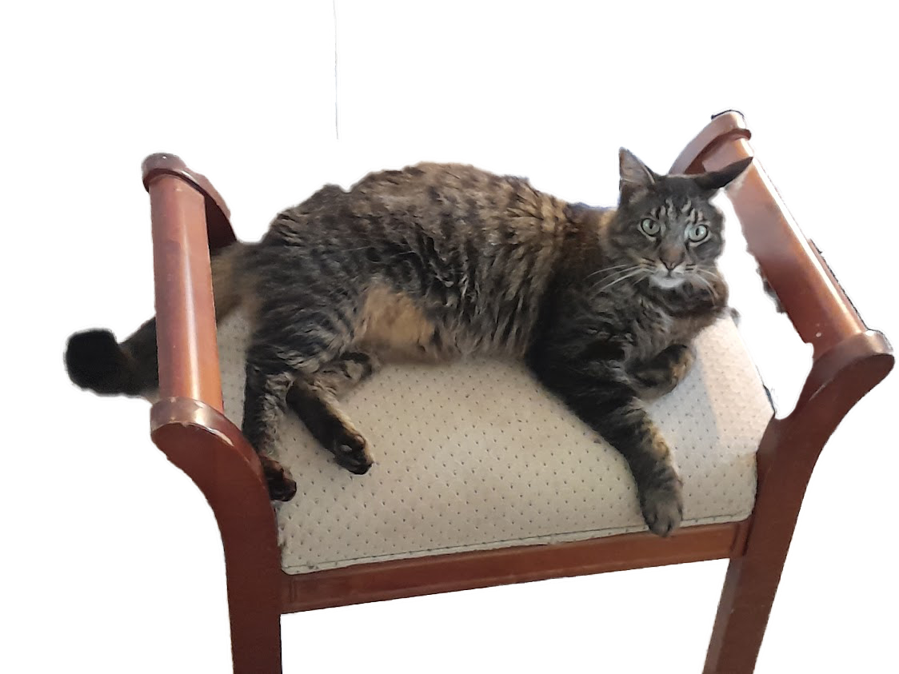
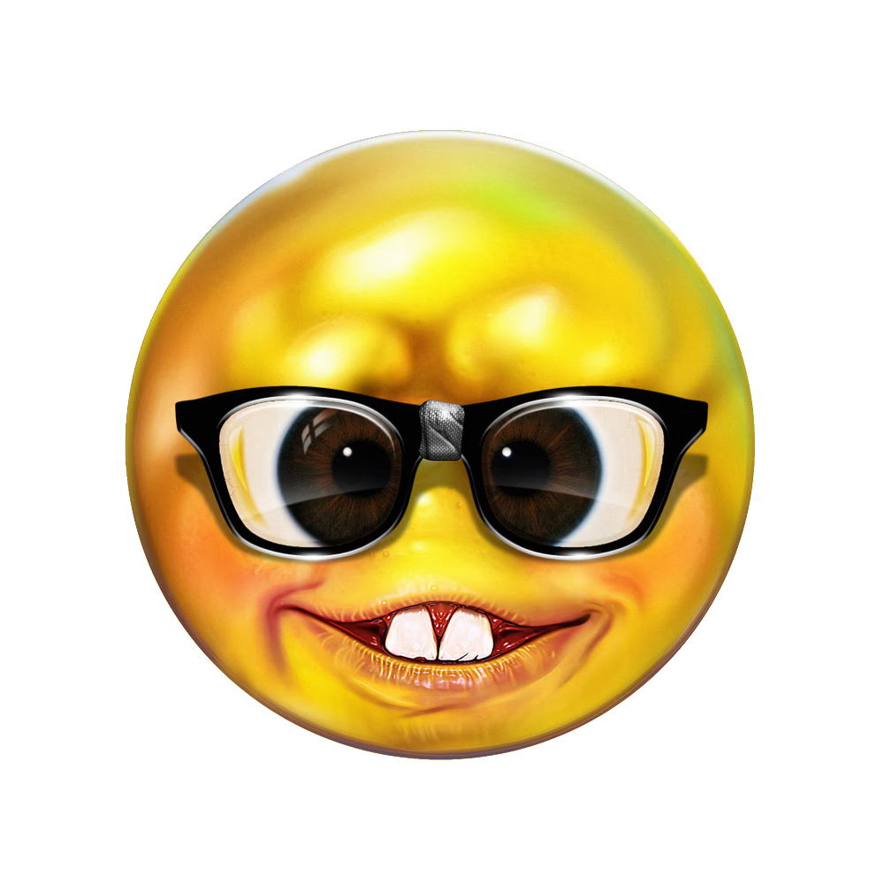

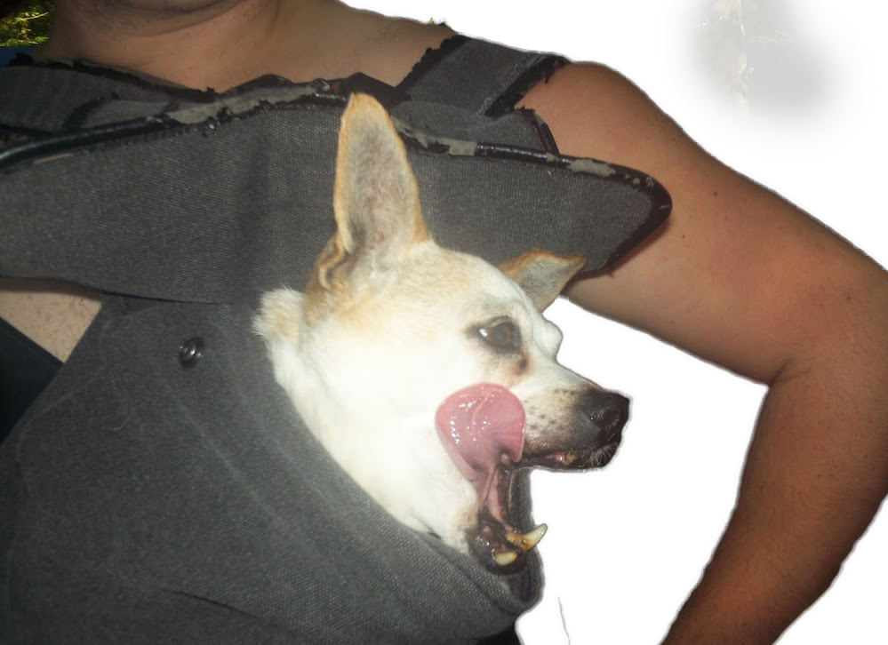
Have a good day!
Reach out! Glad to answer any questions.
Email: AprilMCyr@students.abtech.edu
Check out these and other projects of mine at www.aachips.co/self-introduction
PDF Download in Zoom Chat

